Slide 1
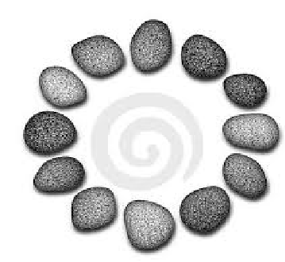

Password Hashing and Graph Pebbling
Samson Zhou
Joint work with:
Jeremiah Blocki, Ben Harsha, Ling Ren

Slide 2
Structure of Talk
Background
Graph Pebbling
“Graph Reducibility”

Slide 3
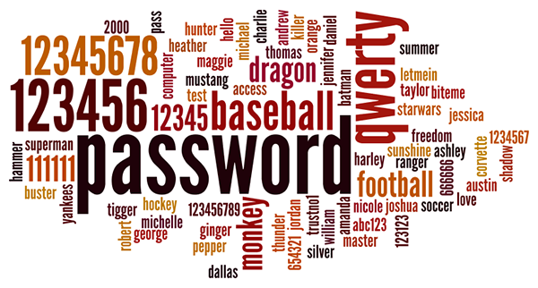
Background
Users tend to pick weak passwords

Slide 4
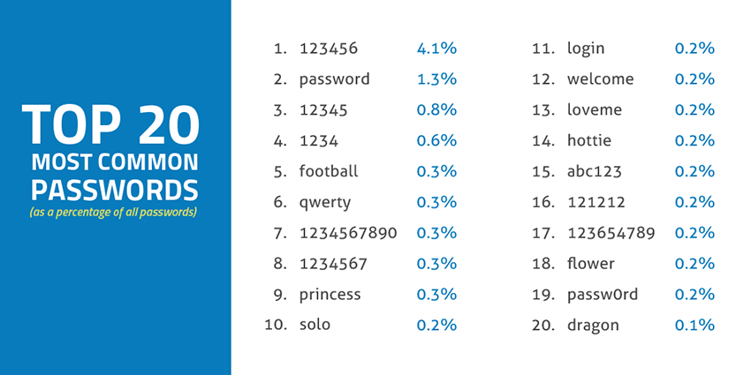
Source: SkyHigh

Slide 5

Background
Users tend to pick weak passwords
Server attacks are inevitable

Slide 6
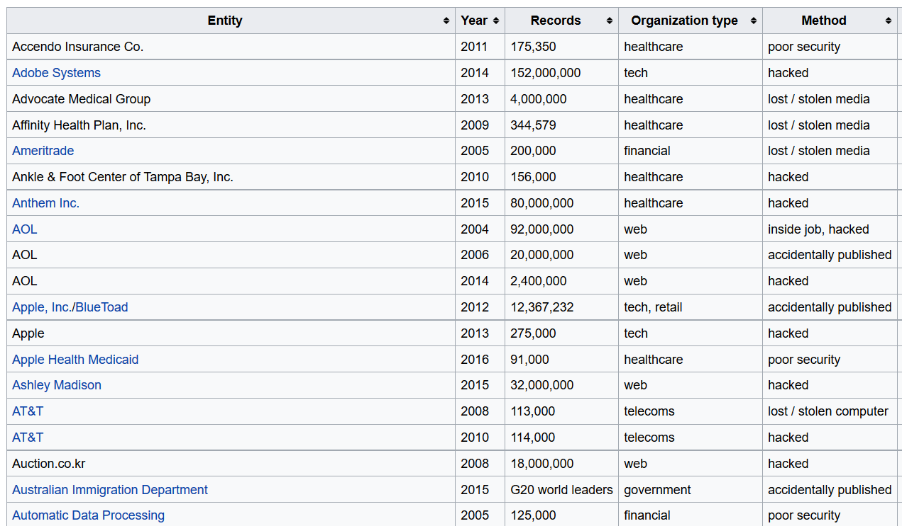

Slide 7
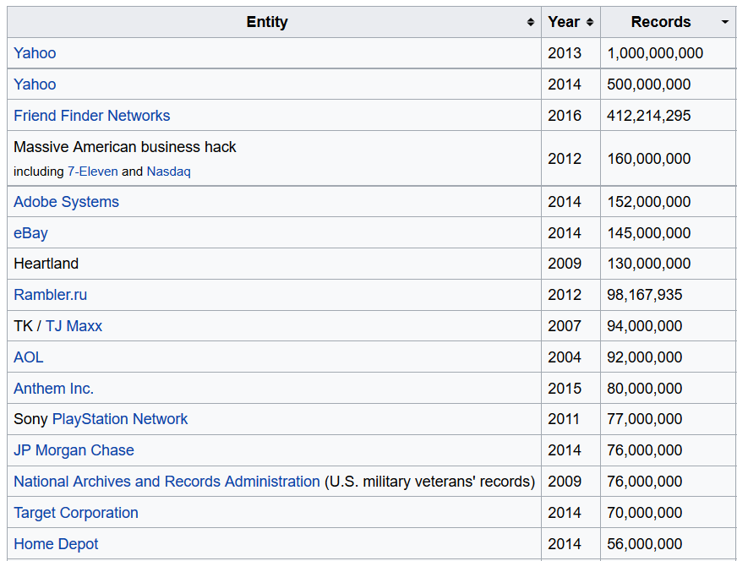

Slide 8















Slide 9





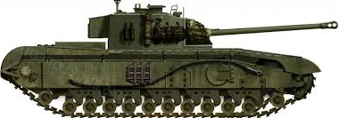

Slide 10
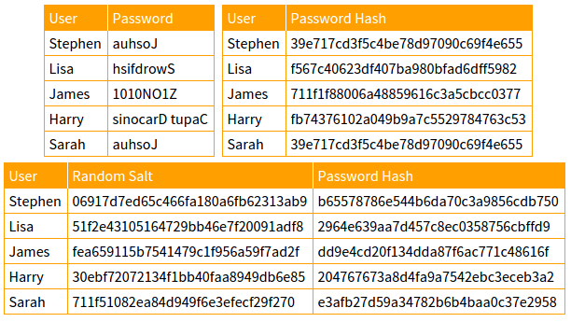

Slide 11
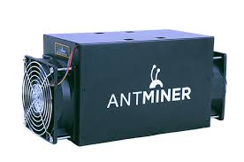
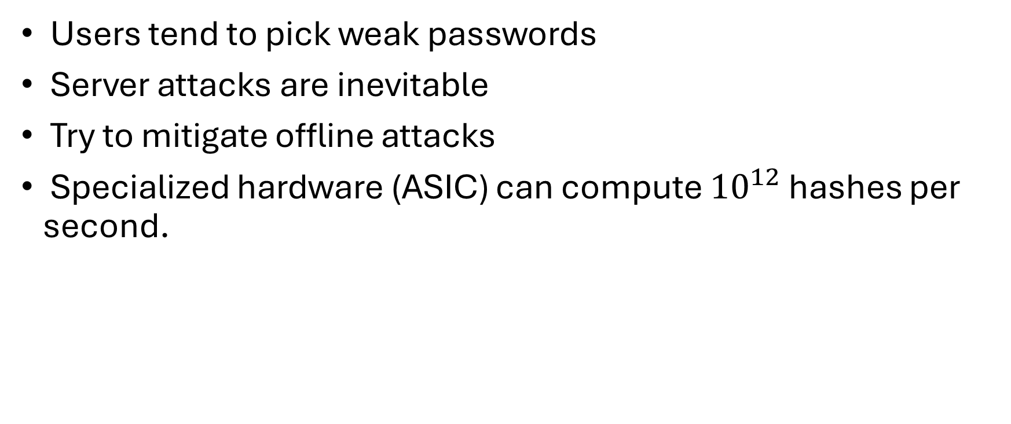
Motivation
Users tend to pick weak passwords
Server attacks are inevitable
Try to mitigate offline attacks
Specialized hardware (ASIC) can compute ${10}^{12}$ hashes per second.

Slide 12

Password Hash Function Goals
“Moderately Expensive” to compute
Expensive to compute on ASIC
Fast and cheap on PC

Slide 13
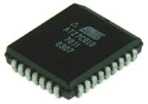
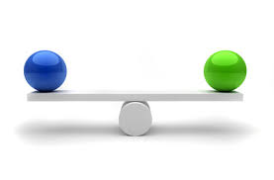


Slide 14
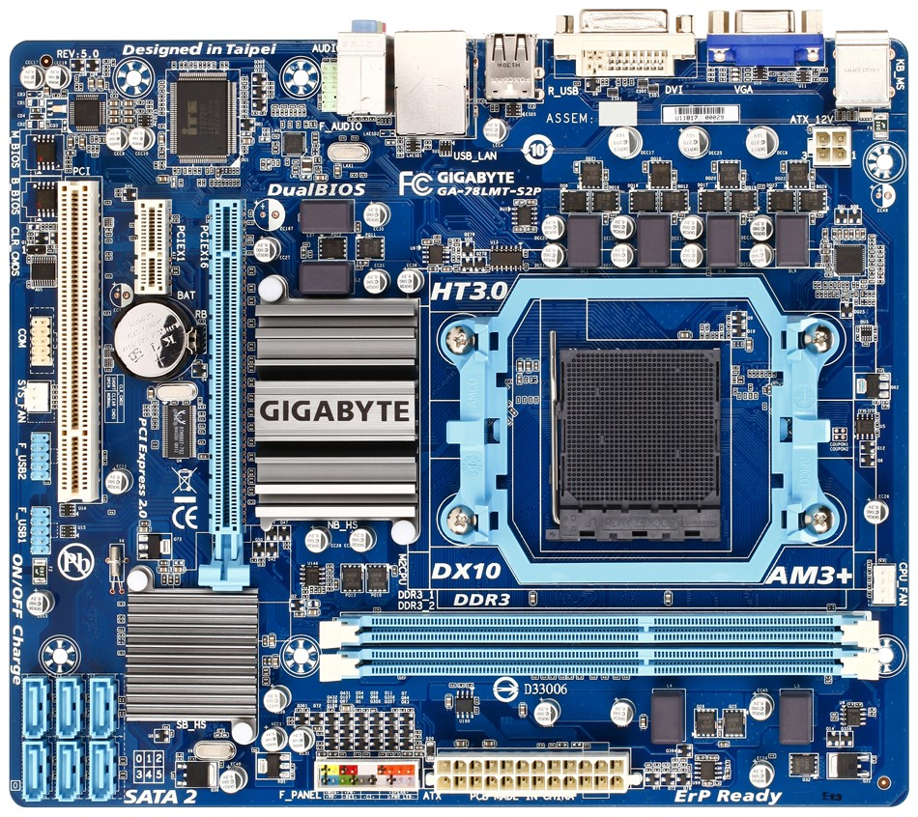
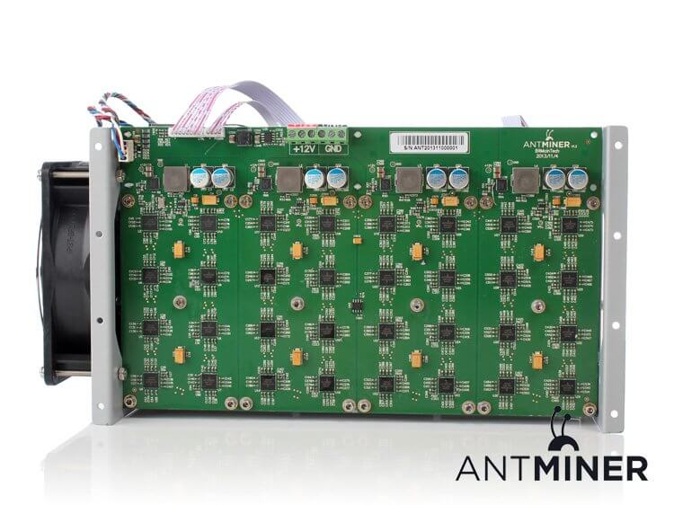

Slide 15
Memory Hard Functions
Memory hard functions require comparatively more resources for adversaries to compute
Data-dependent memory hard functions are susceptible to side-channel attacks
Data-independent memory hard functions (iMHFs)

Slide 16
iMHFs
$$f_{G,H}$$
Hash function: $H$

Slide 17
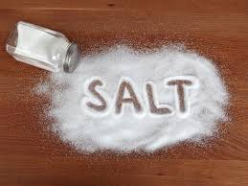
iMHFs
$$f_{G,H}$$
pwd
$$h_{1}$$
$$h_{1}=H(pwd, salt)$$

Slide 18
iMHFs
$$f_{G,H}$$
pwd
$$h_{1}$$
$$h_{2}$$
$$h_{2}=H(h_{1})$$

Slide 19
iMHFs
$$f_{G,H}$$
pwd
$$h_{1}$$
$$h_{2}$$
$$h_{3}$$
$$h_{4}$$
$$h_{3}=H\left(h_{1},h_{2}\right), { h}_{4}=H(h_{2})$$

Slide 20
iMHFs
$$f_{G,H}$$
pwd
$$h_{1}$$
$$h_{2}$$
$$h_{3}$$
$$h_{5}$$
$$h_{4}$$
$$h_{5}=H\left(h_{3},h_{4}\right)$$

Slide 22
iMHFs
Calculating an iMHF can be modeled as graph pebbling [AS15]

Slide 23
Graph Pebbling

Slide 24
Graph Pebbling

Slide 25
Graph Pebbling

Slide 26
Graph Pebbling

Slide 27
Graph Pebbling

Slide 28
Graph Pebbling

Slide 29
Graph Pebbling

Slide 30
Graph Pebbling

Slide 31
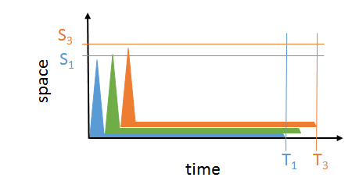
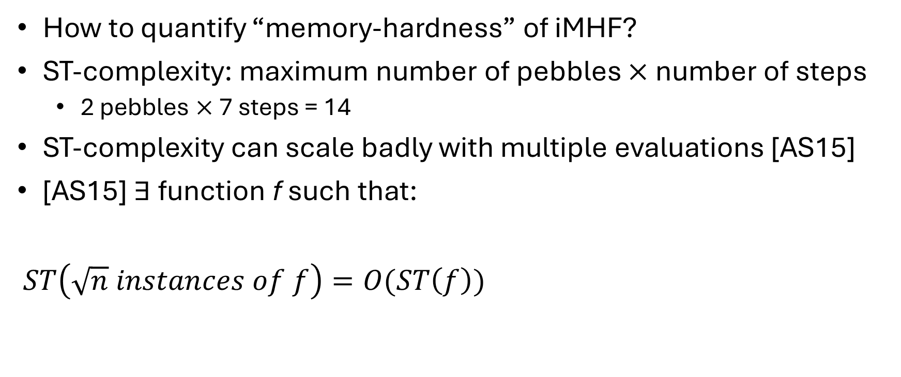
iMHFs
How to quantify “memory-hardness” of iMHF?
ST-complexity: maximum number of pebbles $×$ number of steps
2 pebbles $×$ 7 steps = 14
ST-complexity can scale badly with multiple evaluations [AS15]
[AS15] $∃$function f such that:
$ST\left(\sqrt{n} instances of f\right)=O(ST\left(f\right))$

Slide 32
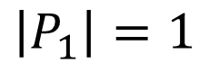
Graph Pebbling
$$\left|P_{1}\right|=1$$

Slide 33
Graph Pebbling
$$\left|P_{1}\right|+\left|P_{2}\right|=1+2=3$$

Slide 34
Graph Pebbling
$$\left|P_{1}\right|+\left|P_{2}\right|+\left|P_{3}\right|=3+2=5$$

Slide 35
Graph Pebbling
$$\sum_{\left\{i=1\right\}}^{4}{|P_{i}|}=5+1=6$$

Slide 36
Graph Pebbling
$$\sum_{\left\{i=1\right\}}^{5}{|P_{i}|}=6+2=8$$

Slide 37
Graph Pebbling
$$\sum_{\left\{i=1\right\}}^{6}{|P_{i}|}=8+2=10$$

Slide 38
Graph Pebbling
$$cc\left(G\right)=\sum_{\left\{i=1\right\}}^{7}{|P_{i}|}=10+1=11$$

Slide 39

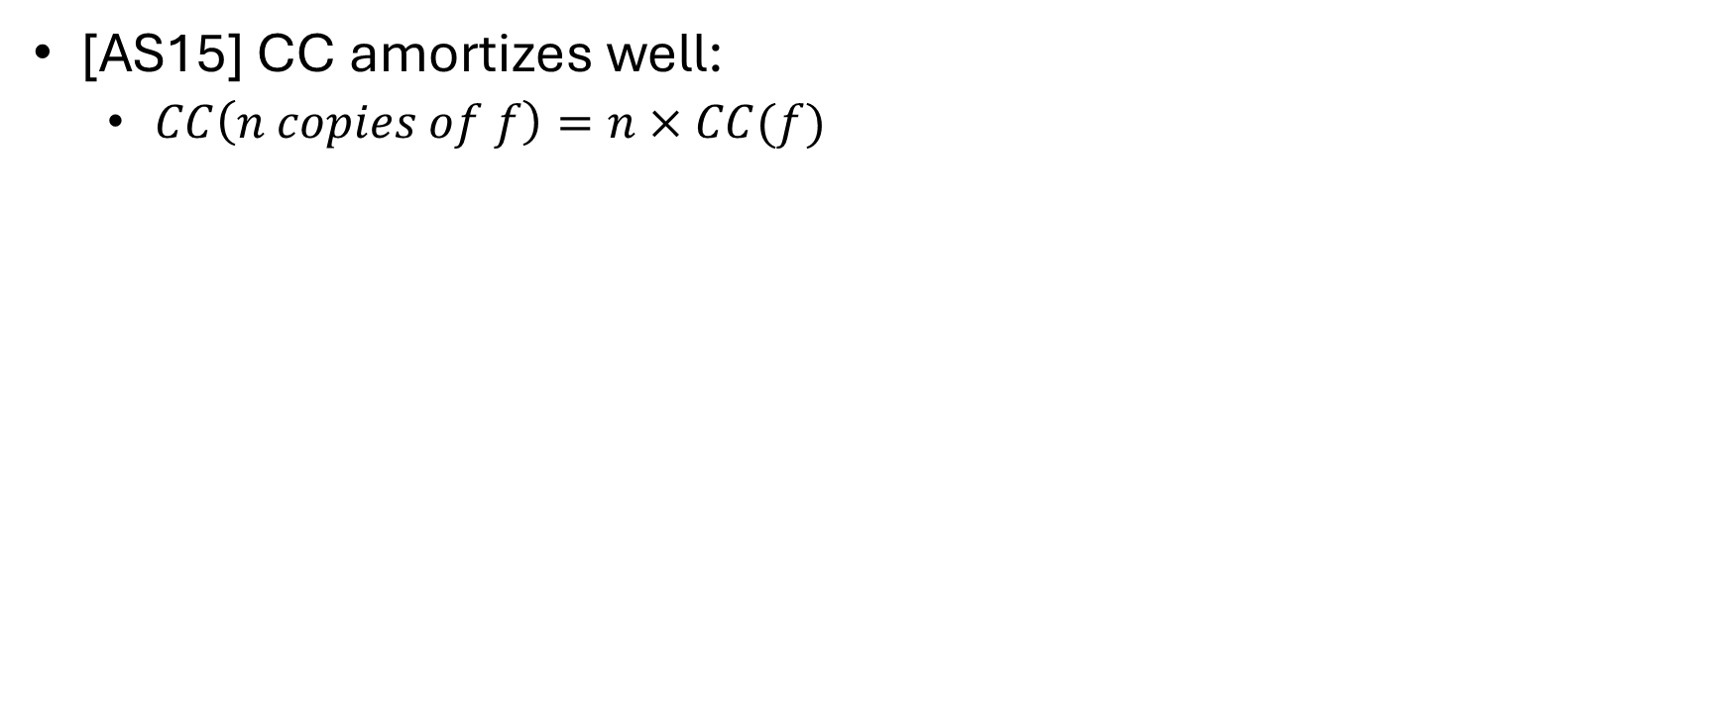
iMHFs
[AS15] CC amortizes well:
$CC\left(n copies of f\right)=n×CC(f)$
$$cc(G)$$ | Lower Bound | Upper Bound
Argon2i [BDK15] | $Ω(n^{1.75})$ [BZ17] | $O(n^{1.767})$ [BZ17]
DRSample [ABH17] | $Ω\left(\frac{n^{2}}{\log{n}}\right)$ [ABH17] | $O\left(\frac{n^{2}\log{\log{n}}}{\log{n}}\right)$ [ABH17]
Gap of $500,000$
$$7.3 ∗{10}^{−6} ∗\frac{n^{2}}{\log{n}}$$
$$\frac{n^{2}}{6}$$

Slide 40
Review
Data-independent memory hard functions require comparatively more resources for adversaries to compute
Calculating an iMHF can be modeled as graph pebbling
Cumulative complexity better model than space-time complexity

Slide 41
Structure of Talk
Background
Graph Pebbling
“Graph Reducibility”

Slide 42
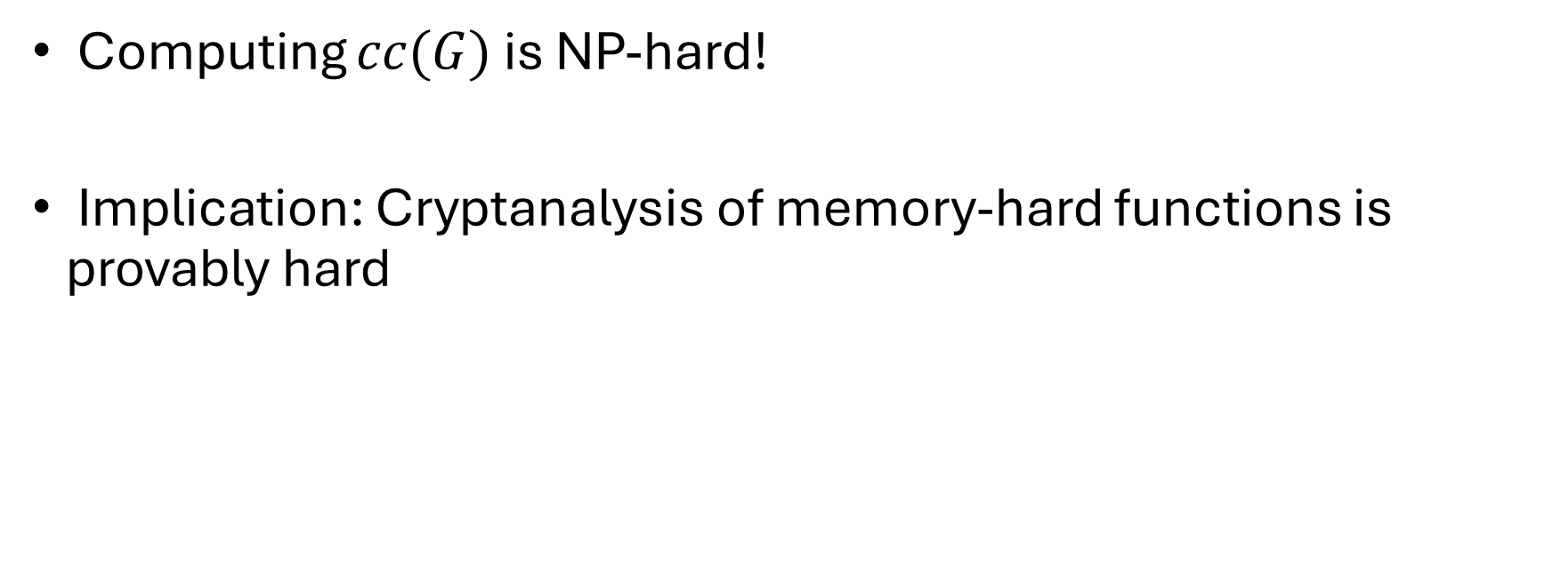
Computability Results
Computing $cc(G)$ is NP-hard!
Implication: Cryptanalysis of memory-hard functions is provably hard

Slide 43
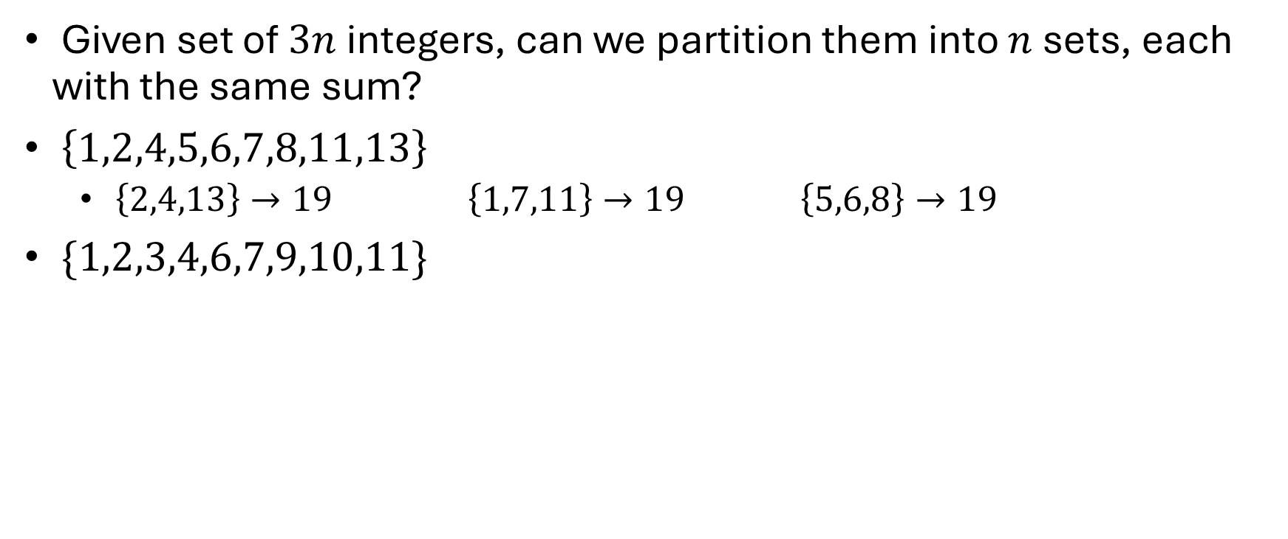
3-PARTITION
Given set of $3n$ integers, can we partition them into $n$ sets, each with the same sum?
$\left\{1,2,4,5,6,7,8,11,13\right\}$
$\left\{2,4,13\right\}→19$ $\left\{1,7,11\right\}→19$ $\left\{5,6,8\right\}→19$
$\{1,2,3,4,6,7,9,10,11\}$

Slide 44
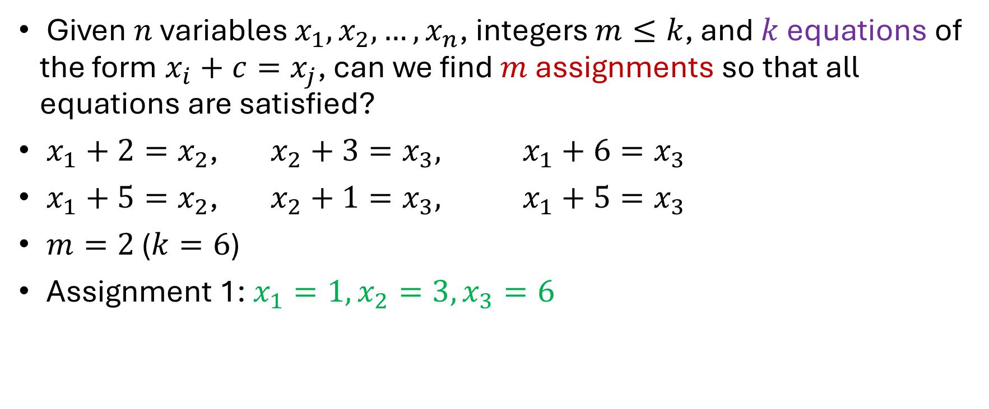
Bounded 2-Linear Covering
Given $n$ variables $x_{1},x_{2},…,x_{n}$, integers $m≤k$, and $k$ equations of the form $x_{i}+c=x_{j}$, can we find $m$ assignments so that all equations are satisfied?
$x_{1}+2=x_{2}$, $x_{2}+3=x_{3},$ $x_{1}+6=x_{3}$
$x_{1}+5=x_{2}$, $x_{2}+1=x_{3},$ $x_{1}+5=x_{3}$
$m=2$ ($k=6$)
Assignment 1: $x_{1}=1,x_{2}=3,x_{3}=6$

Slide 45
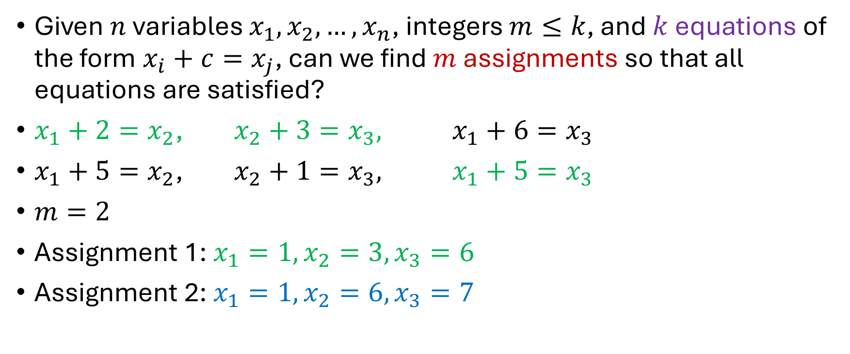
Bounded 2-Linear Covering
Given $n$ variables $x_{1},x_{2},…,x_{n}$, integers $m≤k$, and $k$ equations of the form $x_{i}+c=x_{j}$, can we find $m$ assignments so that all equations are satisfied?
$x_{1}+2=x_{2}$, $x_{2}+3=x_{3},$ $x_{1}+6=x_{3}$
$x_{1}+5=x_{2}$, $x_{2}+1=x_{3},$ $x_{1}+5=x_{3}$
$m=2$
Assignment 1: $x_{1}=1,x_{2}=3,x_{3}=6$
Assignment 2: $x_{1}=1,x_{2}=6,x_{3}=7$

Slide 46
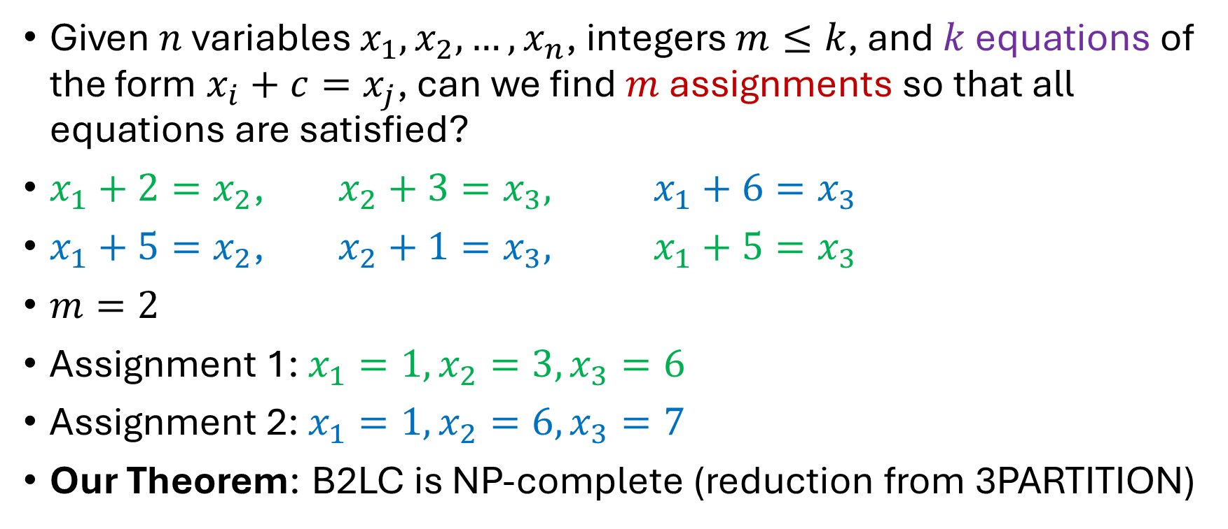
Bounded 2-Linear Covering
Given $n$ variables $x_{1},x_{2},…,x_{n}$, integers $m≤k$, and $k$ equations of the form $x_{i}+c=x_{j}$, can we find $m$ assignments so that all equations are satisfied?
$x_{1}+2=x_{2}$, $x_{2}+3=x_{3},$ $x_{1}+6=x_{3}$
$x_{1}+5=x_{2}$, $x_{2}+1=x_{3},$ $x_{1}+5=x_{3}$
$m=2$
Assignment 1: $x_{1}=1,x_{2}=3,x_{3}=6$
Assignment 2: $x_{1}=1,x_{2}=6,x_{3}=7$
Our Theorem: B2LC is NP-complete (reduction from 3PARTITION)

Slide 47
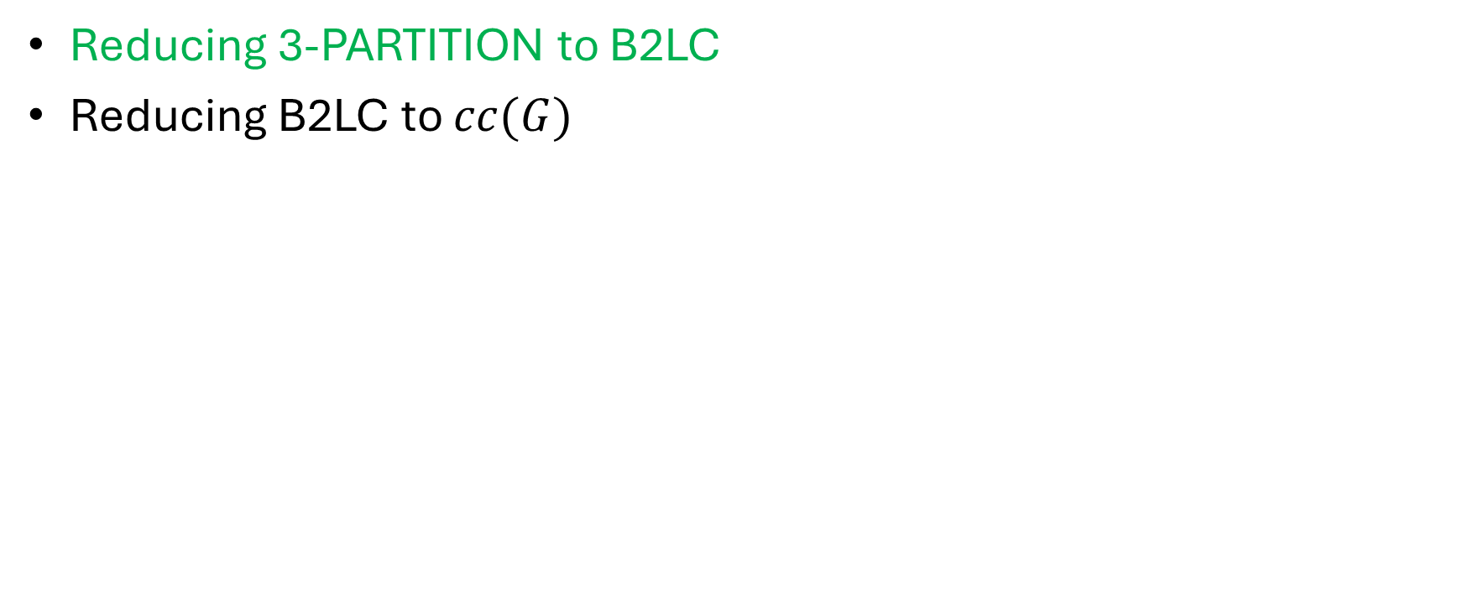
Reductions
Reducing 3-PARTITION to B2LC
Reducing B2LC to $cc(G)$

Slide 48
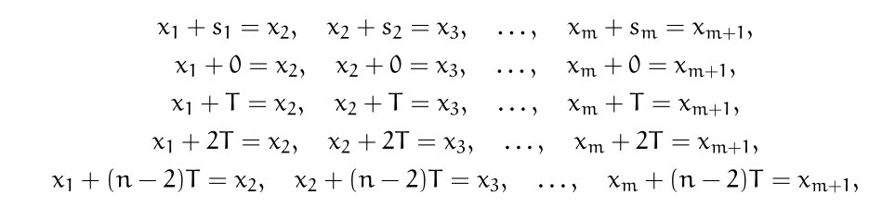
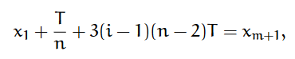
Reductions
$$T=\sum_{\left\{i=1\right\}}^{m}{s_{m}}$$

Slide 49
Reductions
$$m$$
$$n$$
$m=3n$ integers in original 3-PARTITION instance

Slide 50
Reductions
$$m$$
$$n$$
$m=3n$ integers in original 3-PARTITION instance

Slide 51
Reductions
$$m$$
$$n$$
$m=3n$ integers in original 3-PARTITION instance

Slide 52
Reductions
$$m$$
$$n$$
$m=3n$ integers in original 3-PARTITION instance

Slide 53
Reductions
$$m$$
$$n$$
$m=3n$ integers in original 3-PARTITION instance

Slide 54
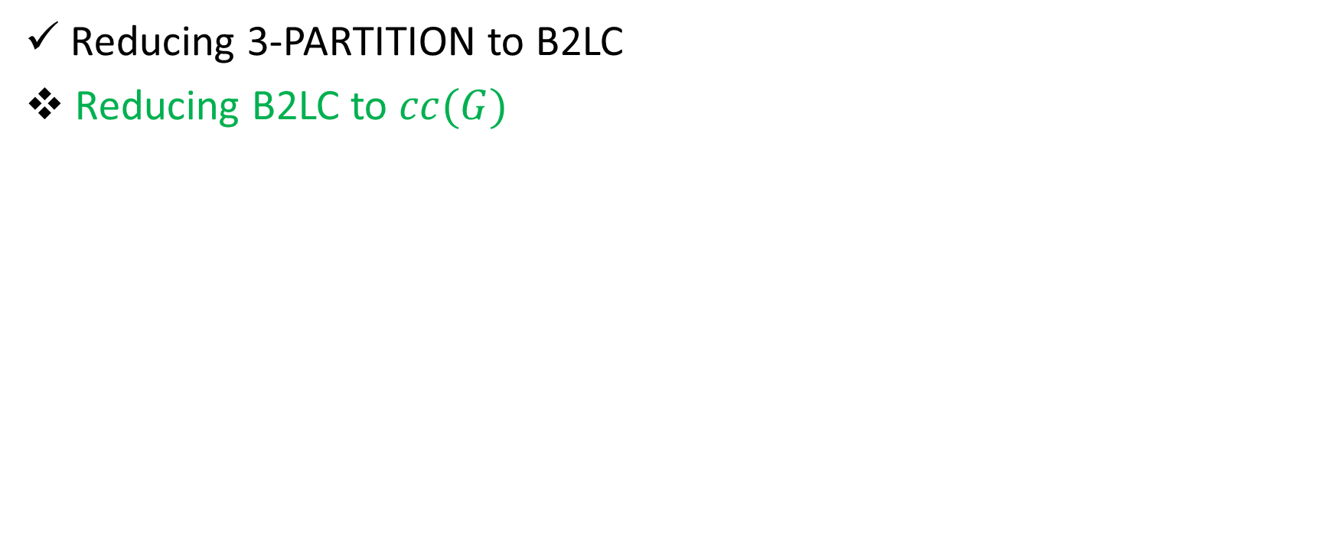
Reductions
Reducing 3-PARTITION to B2LC
Reducing B2LC to $cc(G)$

Slide 55

Reductions
GOAL: If $m$ assignments for$k$ equations, then Pebbling Cost is SMALL.
Otherwise, Pebbling Cost is LARGE
$$x_{1}:$$
$$x_{2}:$$

Slide 56
Reductions
GOAL: If $m$ assignments for$k$ equations, then Pebbling Cost is SMALL.
Otherwise, Pebbling Cost is LARGE
$$x_{1}+2=x_{2}:$$
$$x_{1}:$$
$$x_{2}:$$

Slide 57
Honest Pebbling
GOAL: If $m$ assignments for$k$ equations, then Pebbling Cost is SMALL.
Otherwise, Pebbling Cost is LARGE
$$x_{1}+2=x_{2}:$$
$$x_{1}:$$
$$x_{2}:$$

Slide 58
Honest Pebbling
GOAL: If $m$ assignments for$k$ equations, then Pebbling Cost is SMALL.
Otherwise, Pebbling Cost is LARGE
$$x_{1}+2=x_{2}:$$
$$x_{1}:$$
$$x_{2}:$$

Slide 59
Honest Pebbling
GOAL: If $m$ assignments for$k$ equations, then Pebbling Cost is SMALL.
Otherwise, Pebbling Cost is LARGE
$$x_{1}+2=x_{2}:$$
$$x_{1}:$$
$$x_{2}:$$

Slide 60
Honest Pebbling
GOAL: If $m$ assignments for$k$ equations, then Pebbling Cost is SMALL.
Otherwise, Pebbling Cost is LARGE
$$x_{1}+2=x_{2}:$$
$$x_{1}:$$
$$x_{2}:$$

Slide 61
Honest Pebbling
GOAL: If $m$ assignments for$k$ equations, then Pebbling Cost is SMALL.
Otherwise, Pebbling Cost is LARGE
$$x_{1}+2=x_{2}:$$
$$x_{1}:$$
$$x_{2}:$$

Slide 62
Honest Pebbling
GOAL: If $m$ assignments for$k$ equations, then Pebbling Cost is SMALL.
Otherwise, Pebbling Cost is LARGE
$$x_{1}+2=x_{2}:$$
$$x_{1}:$$
$$x_{2}:$$

Slide 63
Honest Pebbling
GOAL: If $m$ assignments for$k$ equations, then Pebbling Cost is SMALL.
Otherwise, Pebbling Cost is LARGE
$$x_{1}+2=x_{2}:$$
$$x_{1}:$$
$$x_{2}:$$

Slide 64
Cheater!
GOAL: If $m$ assignments for$k$ equations, then Pebbling Cost is SMALL.
Otherwise, Pebbling Cost is LARGE
$$x_{1}+2=x_{2}:$$
$$x_{1}:$$
$$x_{2}:$$

Slide 65
Cheater!
GOAL: If $m$ assignments for$k$ equations, then Pebbling Cost is SMALL.
Otherwise, Pebbling Cost is LARGE
$$x_{1}+2=x_{2}:$$
$$x_{1}:$$
$$x_{2}:$$

Slide 66
Cheater!
GOAL: If $m$ assignments for$k$ equations, then Pebbling Cost is SMALL.
Otherwise, Pebbling Cost is LARGE
$$x_{1}+2=x_{2}:$$
$$x_{1}:$$
$$x_{2}:$$

Slide 67
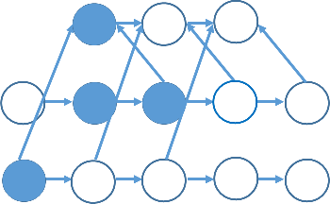
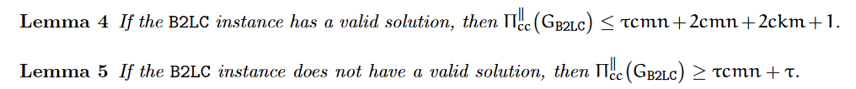
Cheater!

Slide 68
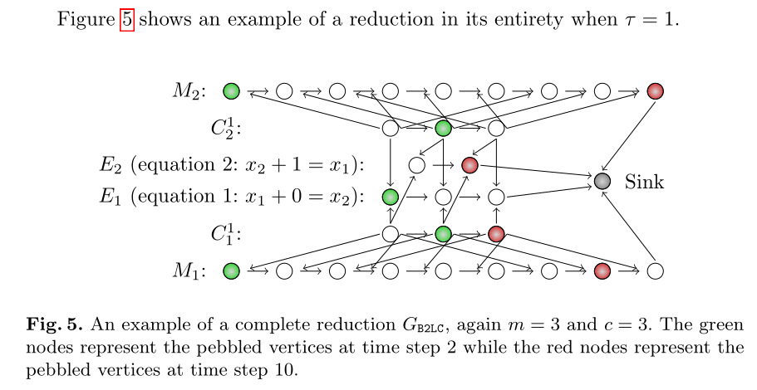
Reductions

Slide 69
Structure of Talk
Background
Graph Pebbling
“Graph Reducibility”

Slide 70
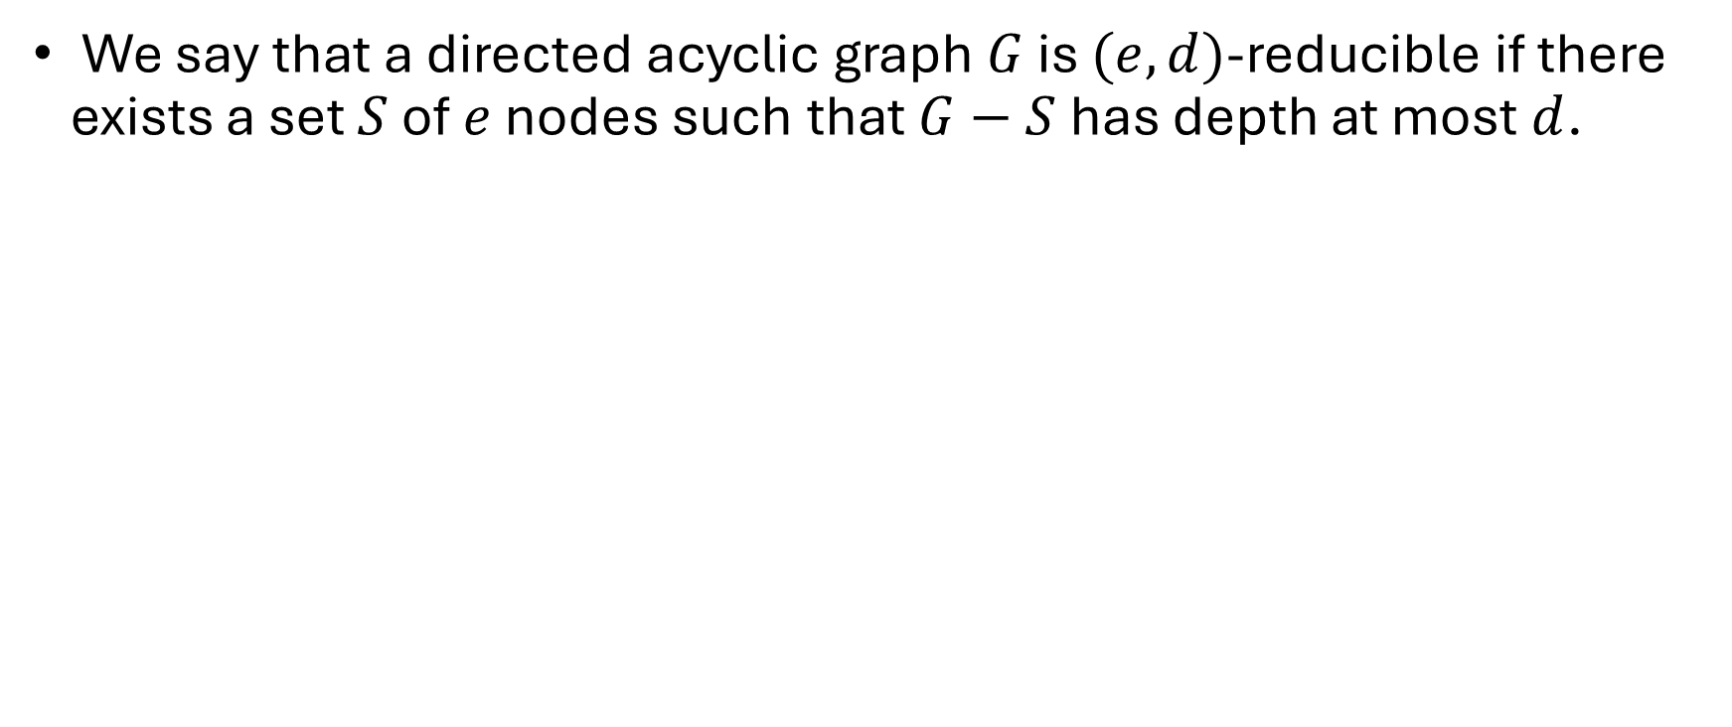
Graph Reducibility
We say that a directed acyclic graph $G$ is $(e,d)$-reducible if there exists a set $S$ of $e$ nodes such that $G−S$ has depth at most $d$.
1
2
3
4
5
6
7
$(1,3)$ - reducible

Slide 71
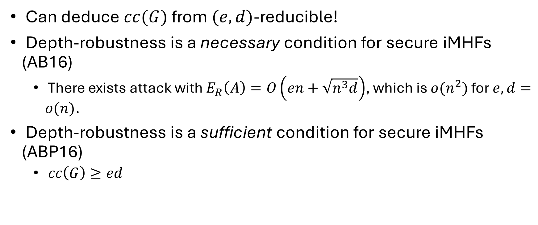
Graph Reducibility
Can deduce $cc(G)$ from $(e,d)$-reducible!
Depth-robustness is a necessary condition for secure iMHFs (AB16)
There exists attack with $E_{R}\left(A\right)=O\left(en+\sqrt{n^{3}d}\right)$, which is $o(n^{2})$ for $e,d=o(n)$.
Depth-robustness is a sufficient condition for secure iMHFs (ABP16)
$cc\left(G\right)≥ed$

Slide 72
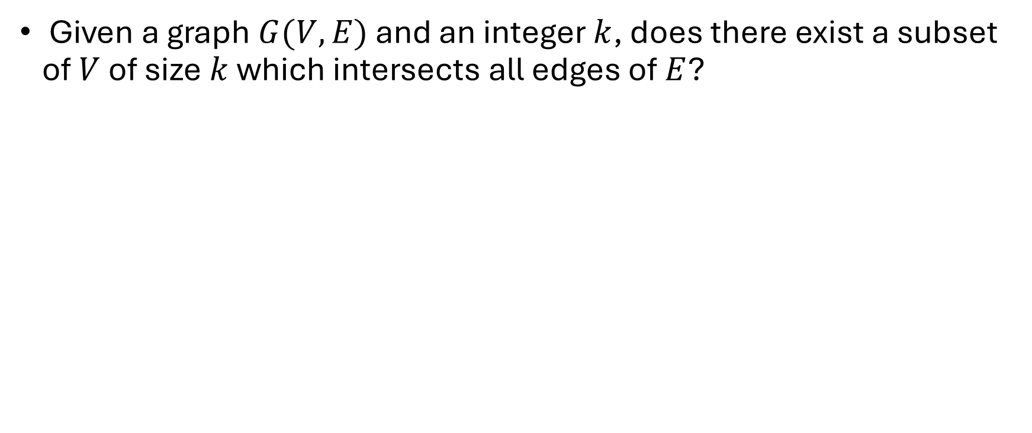
Vertex Cover
Given a graph $G(V,E)$ and an integer $k$, does there exist a subset of $V$ of size $k$ which intersects all edges of $E$?

Slide 73
Vertex Cover
Given a graph $G(V,E)$ and an integer $k$, does there exist a subset of $V$ of size $k$ which intersects all edges of $E$?

Slide 74
Vertex Cover
Given a graph $G(V,E)$ and an integer $k$, does there exist a subset of $V$ of size $k$ which intersects all edges of $E$?

Slide 75
Vertex Cover
Given a graph $G(V,E)$ and an integer $k$, does there exist a subset of $V$ of size $k$ which intersects all edges of $E$?

Slide 76
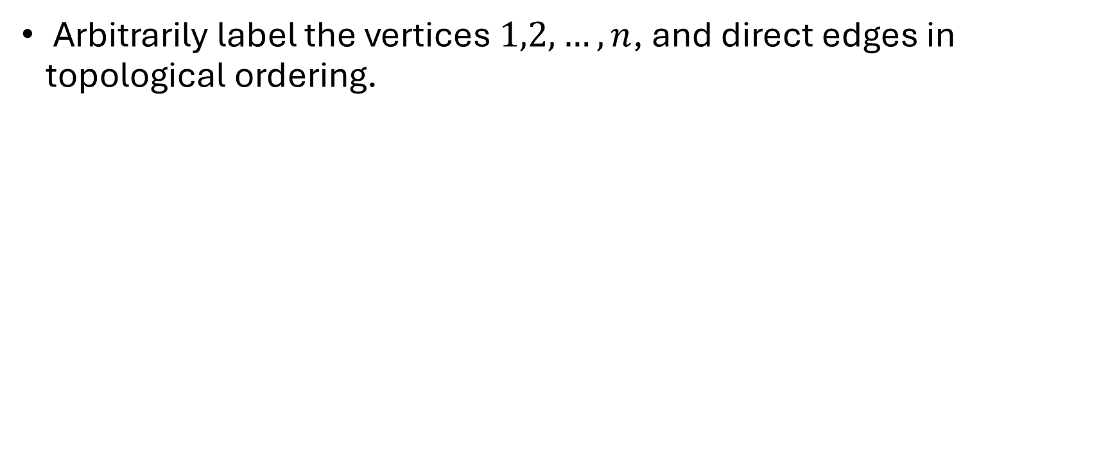
Reduction
Arbitrarily label the vertices $1,2,…,n$, and direct edges in topological ordering.

Slide 77
Reduction
Arbitrarily label the vertices $1,2,…,n$, and direct edges in topological ordering.
1
2
4
5
3

Slide 78
Reduction
Arbitrarily label the vertices $1,2,…,n$, and direct edges in topological ordering.
1
2
4
5
3

Slide 79
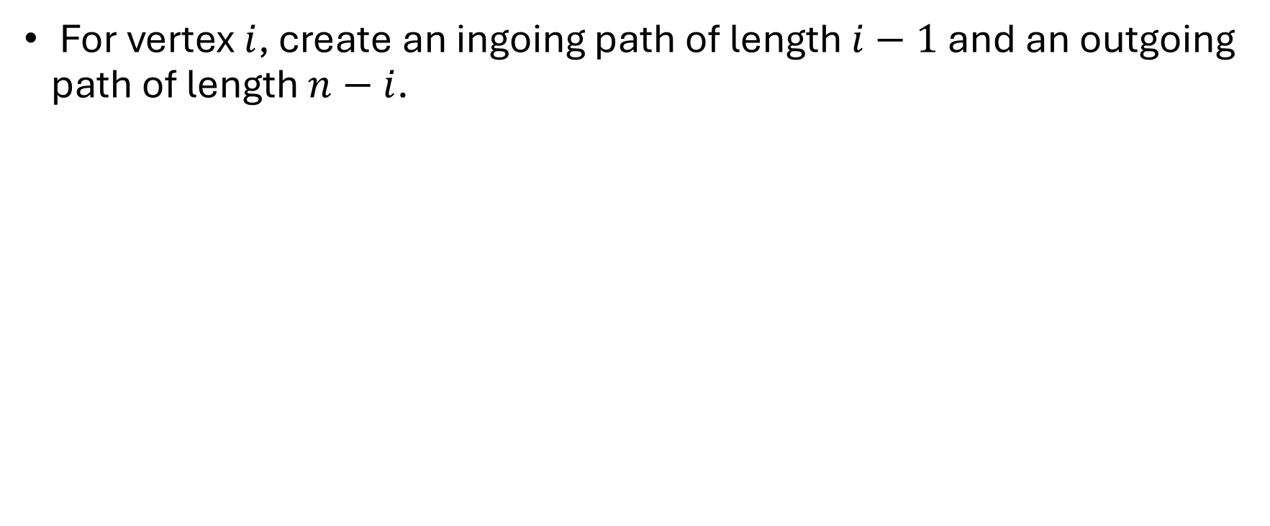
Reduction
For vertex $i$, create an ingoing path of length $i−1$ and an outgoing path of length $n−i$.
1
2
4
5
3

Slide 80
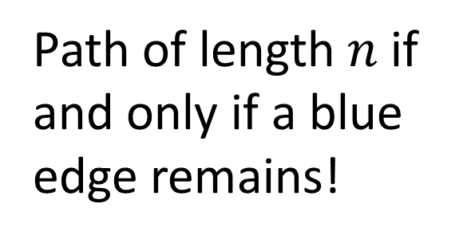
Reduction
4
3
1
3
1
2
4
5
1
3
Path of length $n$ if and only if a blue edge remains!
2
4
2

Slide 81
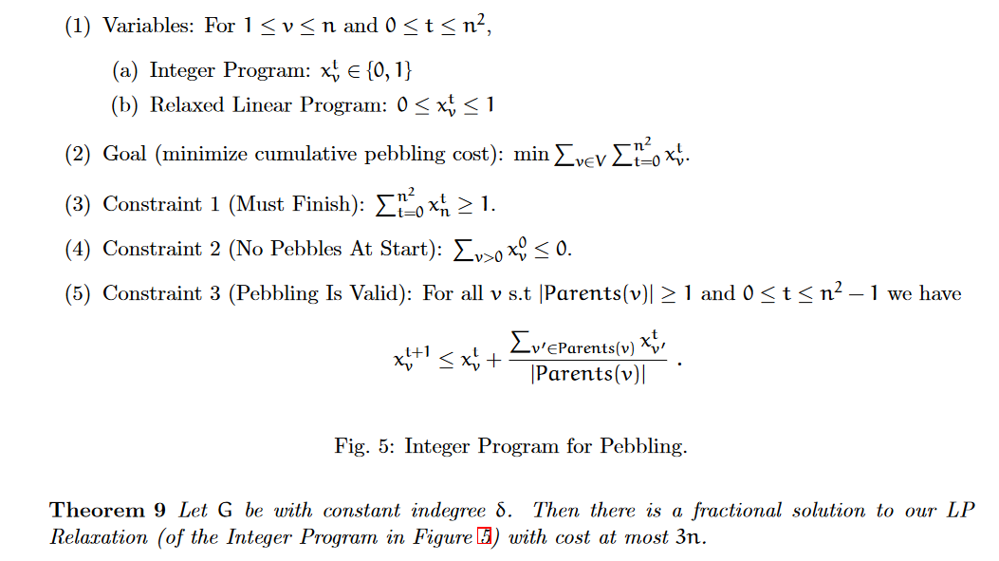


Slide 82
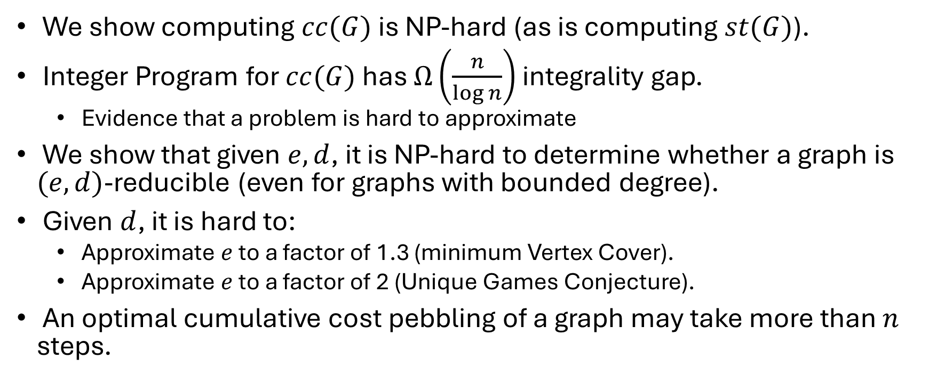
Summary
We show computing $cc(G)$ is NP-hard (as is computing $st(G)$).
Integer Program for $cc(G)$ has $Ω\left(\frac{n}{\log{n}}\right)$ integrality gap.
Evidence that a problem is hard to approximate
We show that given $e,d$, it is NP-hard to determine whether a graph is $(e,d)$-reducible (even for graphs with bounded degree).
Given $d$, it is hard to:
Approximate $e$ to a factor of 1.3 (minimum Vertex Cover).
Approximate $e$ to a factor of 2 (Unique Games Conjecture).
An optimal cumulative cost pebbling of a graph may take more than $n$ steps.

Slide 83
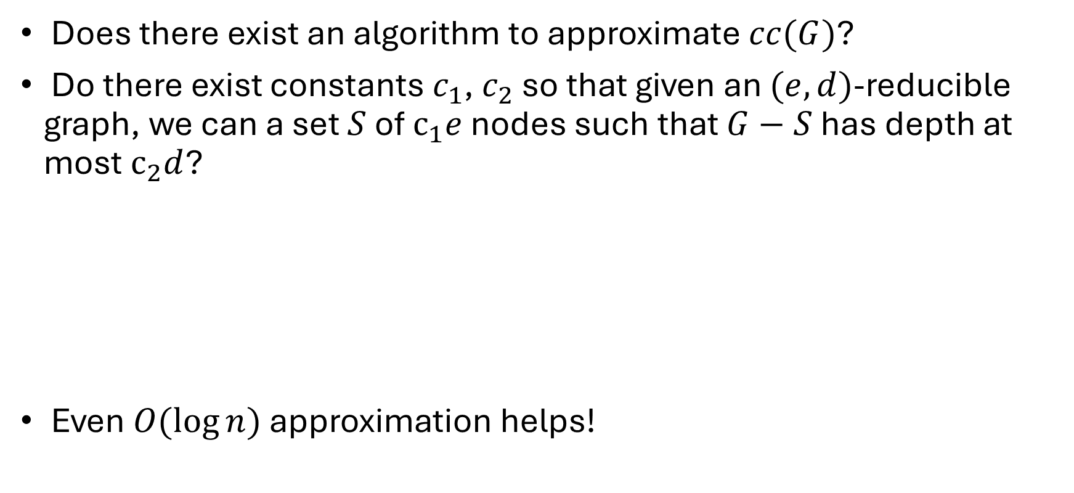
Open Questions
Does there exist an algorithm to approximate $cc(G)$?
Do there exist constants $c_{1}$, $c_{2}$ so that given an $(e,d)$-reducible graph, we can a set $S$ of $c_{1}e$ nodes such that $G−S$ has depth at most $c_{2}d$?
Even $O(\log{n)}$ approximation helps!
1
2
3
4
5
6
7
$(1,3)$ - reducible

Slide 84


Slide 85
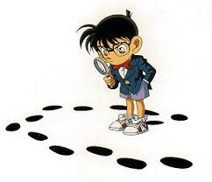
Questions?

